Slide 1
Chapter 4
Creativity
and
the Business Idea
McGraw-Hill/Irwin
Copyright © 2010 by The McGraw-Hill Companies, Inc. All rights reserved.

Slide 2
Sources of New Ideas
Consumers
  Informally monitor potential ideas and needs.
  Formally arrange for consumers to express their opinions.
Existing Products and Services
  Analysis uncovers ways to improve offerings that may result in a new product or service.
Distribution Channels
  Channel members can help suggest and market new products.
Notes:
https://www.studocu.com/row/document/technical-university-of-kenya/entrepreneurship/business-idea-generation-i/20012137

Slide 3
Sources of New Ideas (cont.)
Federal Government
  Files of the Patent Office can suggest new product possibilities.
  New product ideas can come in response to government regulations.
Research and Development
  A formal endeavor connected with one’s current employment.
  An informal lab in a basement or garage.

Slide 4
Methods of Generating New Ideas
Focus Groups
  A moderator leads a group of 8 to 14 participants through an open, in-depth discussion in a directive or nondirective manner.
  An excellent method for generating and screening ideas and concepts.
Notes:
This technique helps to come up with unique ideas. Here you take two unrelated things and imagine putting them together to see what new thing you can come up with.
For example, take a calculator and a pencil, these are unrelated to each other. Now try putting them together. You might get some interesting ideas like a calculator with a touch screen and a pencil to write on it and a lot more.

Slide 5
Methods of Generating New Ideas (cont.)
Brainstorming
  Allows people to be stimulated to greater creativity.
  Good ideas emerge when the brainstorming effort focuses on a specific product or market area.
  Rules of brainstorming:
    No criticism.
    Freewheeling is encouraged.
    Quantity of ideas is desired.
    Combinations and improvements of ideas are encouraged.
Notes:
Brainstorming: This is a method of generating creative ideas and solutions to the problems and challenges you have identified. To use this method, you can organize a brainstorming session with your team, partners, or stakeholders, and ask them to come up with as many ideas as possible for addressing the challenges and growing the venture. Write down all the ideas on a whiteboard or a sheet of paper. Once you have a list of ideas, you can then evaluate and refine them, and choose the ones that are most feasible and effective.

Slide 6
Methods of Generating New Ideas (cont.)
Brainwriting
  A form of written brainstorming.
  Participants write their ideas on special forms or cards that circulate within the group.
Problem Inventory Analysis
  Consumers are provided with a list of problems and are asked to identify products that have those problems.
  Results must be carefully evaluated as they may not actually reflect a new business opportunity.
Notes:
In this technique, a group of people writes their ideas on a piece of paper. After the designated time for writing is over the paper is given to a different person. Now this person reads the ideas on the paper they got and adds their ideas on the paper. This continues until everyone has put their ideas on all the papers. And following this, there is a discussion on each idea.
Problem Inventory Analysis: it is a method for obtaining new ideas and solutions by focusing on problems. This analysis uses individuals in a manner that is analogous to focus groups to generate new product areas. However, instead of generating new ideas, the consumers are provided with list of problems and then asked to have discussion over it and it ultimately results in an entirely new product idea

Slide 7
Creative Problem Solving
Creativity tends to decline with age, education, lack of use, and bureaucracy.
Latent creative potential can be stifled by perceptual, cultural, emotional, and organizational factors.
Creativity can be unlocked by using any of the creative problem-solving techniques.

Slide 8
Creative Problem Solving (cont.)
Brainstorming
  Session starts with a problem statement.
  No group member should be an expert in the field of the problem.
  All ideas must be recorded.
Reverse Brainstorming
  A group method that focuses on the negative aspects of a product, service, or idea as well as ways to overcome these problems.
  Care must be taken to maintain group morale.
Notes:
This technique is quantitative meaning that you come up with a large number of ideas. Here a group comes up with a different possible solution to the problem.
For example, if you along with some of your colleagues are trying to come up with a tagline for your product. And each one of you gives your ideas, then that is called brainstorming.
For example, let us assume you want to know ‘how to increase your followers on social media platforms. According to this technique, you will instead think of ‘how will I not increase my followers on social media platform’.
To this question, you will get answers like, by not posting regularly, or posting lowquality content, etc. Now you just have to reverse your answers. So, to increase followers on a social media platform you should post high-quality content regularly. This idea generation technique works on the concept that it’s easier to come up with negative suggestions.

Slide 9
Creative Problem Solving (cont.)
Gordon Method
  Method for developing new ideas when the individuals are unaware of the problem.
  Solutions are not clouded by preconceived ideas and behavioral patterns.
Checklist Method
  Developing a new idea through a list of related issues.
Free Association
  Developing a new idea through a chain of word associations.
Notes:
Gordon method: Gordon method is a method of developing new ideas when the individuals are unaware of the problem. In this method the entrepreneur starts by mentioning a general concept associated with the problem. The group responds with expressing a number of ideas.
checklist is a comprehensive list of questions about ideas and problems which can be used either individually or in groups. Aims to encourage creativity and divergence in concept generation.

Slide 10
Creative Problem Solving (cont.)
Forced Relationships
  Developing a new idea by looking at product combinations.
  A five step process which focuses on generating ideas from relationship patterns between elements of a problem.
Collective Notebook Method
  Developing a new idea by group members regularly recording ideas.
Notes:
This technique helps to come up with unique ideas. Here you take two unrelated things and imagine putting them together to see what new thing you can come up with.
For example, take a calculator and a pencil, these are unrelated to each other. Now try putting them together. You might get some interesting ideas like a calculator with a touch screen and a pencil to write on it and a lot more.
Collective Notebook Method: This is a method of sharing ideas and insights among team members, partners, or stakeholders. To use this method, you can create a shared document or notebook that everyone can access and contribute to. Encourage everyone to write down their ideas, insights, and feedback in the notebook. You can then review the contents of the notebook periodically and use the ideas and insights to inform your decision-making and planning.

Slide 11
Creative Problem Solving (cont.)
Attribute Listing
  Developing a new idea by looking at the positives and negatives.
Big-Dream Approach
  Developing a new idea by thinking without constraints.
Parameter Analysis
  Developing a new idea by focusing on parameter identification and creative synthesis.
Notes:
Parameter Analysis
This is a method of developing new ideas by focusing on parameter identification and creative synthesis.
Parameter identification involves the analysis of variables contained in the situation to determine their relative importance.
These variables thereafter become the focus of the investigation with other variables being set aside

Slide 12
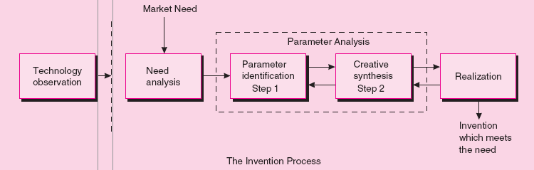
Figure 4.1 - Illustration of Parameter Analysis

Slide 13
Innovation
Types of Innovation
  Breakthrough
    Fewest number of innovations.
    Establishes the platform on which future innovations in an area are developed.
    Should be protected by patents, trademarks, and copyrights.
  Technological
    Occurs more frequently; not at the same level of breakthrough inventions.
    Offers advancements in the product/market area.
    Needs to be protected.
Notes:
Breakthrough innovations include such ideas as penicillin, the steam engine, the computer, the airplane, the automobile, the Internet.
Technological innovation: Such innovations as the personal computer, the flip watch for containing pictures, voice and text messaging, and the jet airplane are examples of technological innovations. The company continues to explore other technological innovations such as an advanced blood test product for diagnosing cancer, a product for extending the shelf life of blood platelets.

Slide 14
Innovation (cont.)
  Ordinary
    Occurs most frequently.
    Extends a technological innovation into a better product or service or one that has a different market appeal.
    Usually come from market analysis and pull, not technology push.

Slide 15
Innovation (cont.)
Defining a New Innovation (Product or Service)
  Newness can be:
    In the consumer concept.
    A change in the package or container.
    Slight changes or modifications in the appearance of the product. (Industrial market)
  Companies also add products to their product line that are already marketed by other companies; products are new to the manufacturer but not the consumer.
Notes:
old products have simply been marketed in new packages or containers but have been identified as new products.
each new version of Microsoft Word usually has mostly minor improvements.
In the process of expanding their sales volume, many companies add products to their product line that are already marketed by other companies.

Slide 16
Innovation (cont.)
Classification of New Products
  Consumer’s Viewpoint
    The continuum proposed by Thomas Robertson is based on the disrupting influence that use of the product has on established consumption patterns.
      Continuous innovations.
      Dynamically continuous.
      Discontinuous innovations.
    This approach is consistent with the marketing philosophy that “satisfaction of consumer needs” is fundamental to a venture’s existence.
Notes:
“continuous innovations” end of the continuum. Examples are annual automobile style changes, fashion style changes, package changes, or
product size or color changes.
Products such as compact discs, the Sony Walkman, and the iPod tend toward the “dynamically continuous” portion of the continuum. The
truly new products, called “discontinuous innovations,” are rare and require a great deal of new learning. The Internet is one example of a discontinuous innovation that has radically altered our society’s
lifestyle.

Slide 17
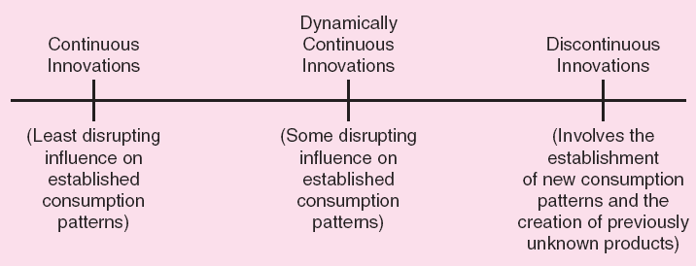
Figure 4.3 - Continuum for Classifying New Products

Slide 18
Innovation (cont.)
  Firm’s Viewpoint
    Distinction can be made between new products and new markets.
    Situations with a new technology and a new market are the most complicated and pose the highest degree of risk.

Slide 19
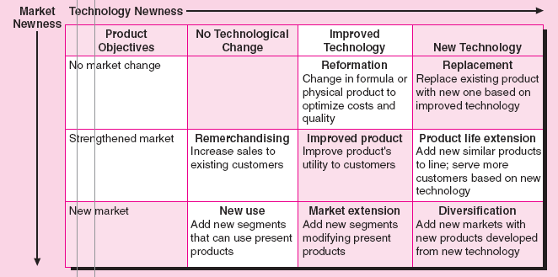
Figure 4.4 - New Product Classification System

Slide 20
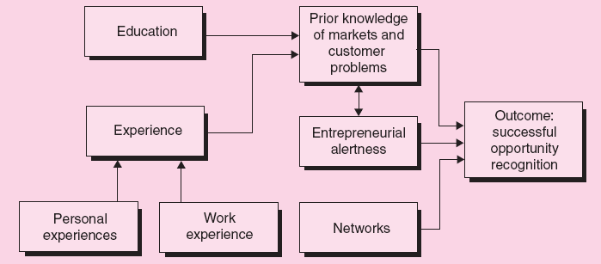
Figure 4.5 - A Model of the
Opportunity Recognition Process

Slide 21
Product Planning and Development Process
Establishing Evaluation Criteria
  Criteria should be established at each stage of the product planning and development process.
  It should be all-inclusive and quantitative in nature.
  Criteria should evaluate the idea in terms of:
    Market opportunity.
    Competition.
    Marketing system.
    Financial factors.
    Production factors.

Slide 22
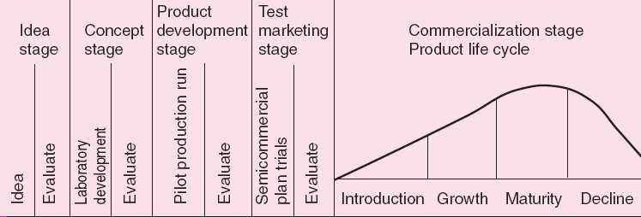
Figure 4.6 - The Product Planning and Development Process

Slide 23
Product Planning and Development Process (cont.)
Idea Stage
  Promising ideas should be identified and impractical ones eliminated.
  Evaluation method – Systematic market evaluation checklist.
  Determine the need for the new idea as well as its value to the company.
Concept Stage
  Refined idea is tested to determine consumer acceptance which can be measured through the conversational interview method.

Slide 24
Product Planning and Development Process (cont.)
Product Development Stage
  Consumer reaction to the product/service is determined.
  A consumer panel is given a product sample and preference is determined through methods such as multiple brand comparisons, risk analysis, etc.
Test Marketing Stage
  Increases certainty of successful commercialization.
  Actual sales reflect consumer acceptance.

